Slide 1
Static Analysis using Llama 3.2
By Tulasi Rama Raju

Slide 2
Motivation
The classic static analysis tools use an already defined set of rules and pattern identification methods to detect vulnerabilities and code failures
leads to limited coverage of the code base when faced with higher level logic flaws.
LLMs can enhance or complement existing static analyzers by having better performance.
A more semantic reasoning.

Slide 3
Scope of LLMs for Static Analysis
We can use LLMs to understand relationships across classes, interpret intent behind logic, and flag inconsistencies quicker.
Can identify correctness problems, bad practices, performance risks, security concerns, and stylistic issues.
Can be used to produce human-readable explanations and summaries of the code.
Generate visual and statistical reports to compare the overlapping scenarios and also the differences.

Slide 4

Used Model - Llama 3.2
The Meta Llama 3.2 collection of multilingual large language models (LLMs) is a collection of pretrained and instruction-tuned generative models in 1B and 3B sizes.
Optimized for multilingual dialogue use cases, including agentic retrieval and summarization tasks.
Allows prompt rewriting and is generally faster than some of the industry standard LLMs.
Source - Ollama

Slide 5
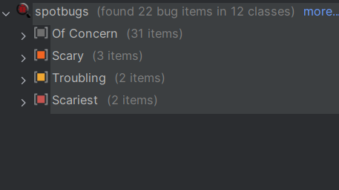
Traditional Static Analysis with SpotBugs
Examines Java bytecode and categorizes issues according to severity (rank), confidence, and type, such as correctness, performance, or bad practice.
Produces XML and HTML reports containing all detected issues.
Does not attempt deeper reasoning about program behavior or design.

Slide 6
Code Comprehension with llama 3.2
Using the Ollama API, the system generates an HTML explanation that describes the purpose of each class, major fields, key methods, and how the components interact across the project.
Describes how the project works internally, clarifying responsibilities within.
Also supports JSON files, which can be repurposed to further development of the application.

Slide 7
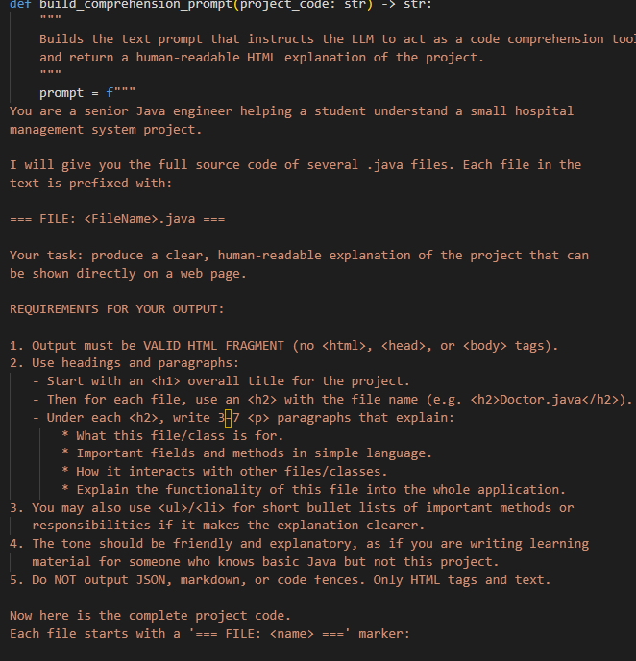
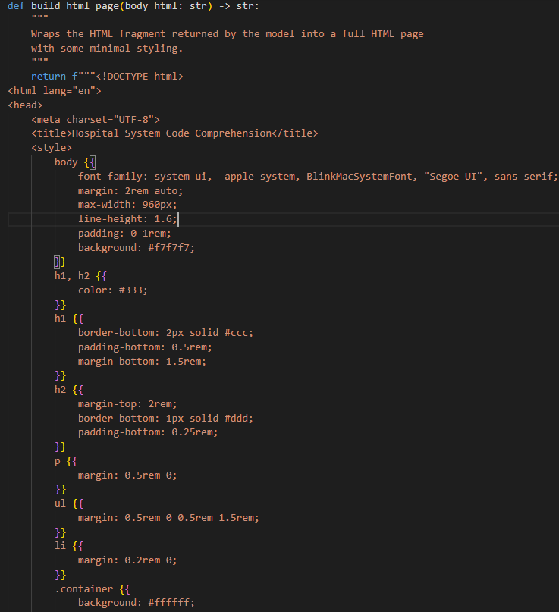
Code Comprehension prompts

Slide 8
Llama 3.2 Static Analysis
Relies on custom Python scripts that load all .java files, construct an analysis prompt, and send it to the Llama 3.2 model via Ollama’s local REST API.
Returns a structured JSON list of issues, each containing the file name, line number, category, severity, short title, and detailed description.
Extremely dependent on prompts – Make or break.
Llama’s flexible reasoning capabilities help in identify logical issues, design flaws, and subtle risks that SpotBugs may overlook.

Slide 9
Process
Locate and Load code files
Build Proper Prompts
Call local Ollama API
Llama 3.2 processing
Extract and Validate Json array of issues
Save Output Files

Slide 10
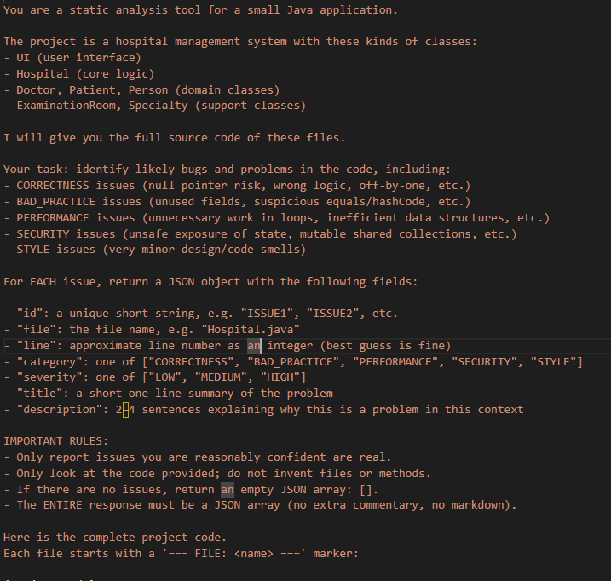
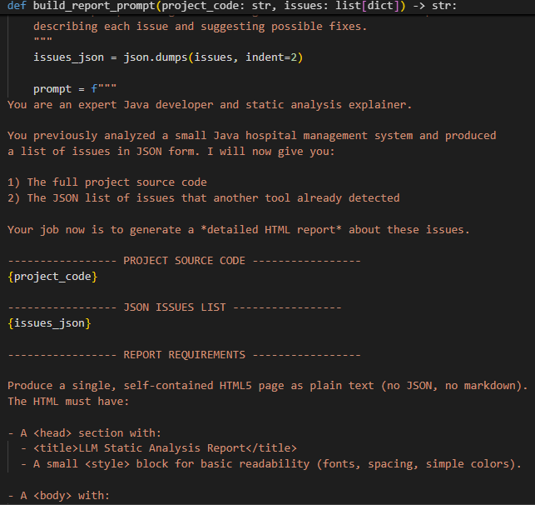
Prompts

Slide 11
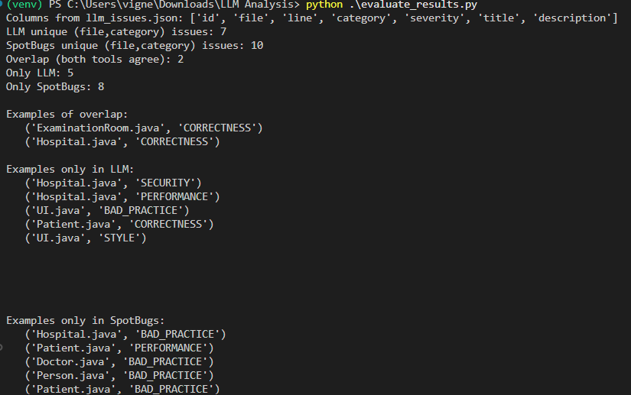
Evaluation

Slide 12
Problems…………
Completely prompt dependent
LLM outputs are inherently probabilistic, meaning the model may generate false positives.
Produce inconsistent results when given the same prompt multiple times.
Output quality may vary depending on available computing power and hardware.
Larger code bases mean there is no guarantee of complete code coverage.

Slide 13
Future Scope
Better model with better computing power yields better results
Can quantify how these approaches complement each other by measuring overlaps, differences, precision, and recall of detected issues.
Potential opportunity to create hybrid pipelines where LLMs post-process or refine traditional static analysis reports, generating more actionable developer guidance.
Can optimize prompts to generate complete documentation of the bugs.

Slide 14
Conclusions
LLMs introduce contextual reasoning.
Stronger models can detect subtle and architectural defects.
Can attain an overall better understanding of the code with the help of quick and simple code summarization.
Can optimize prompts to generate complete documentation of the bugs.

